Slide 1
4x4 – Centers
COLL 134
Week 9

Slide 2
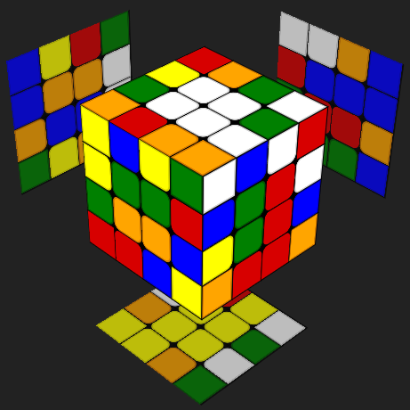
General Concepts
Each center = 2x2 block of “mini-centers”
For each center, create two 1x2 strips, aka “half-centers”
Align matching half-centers to get complete center

Slide 3
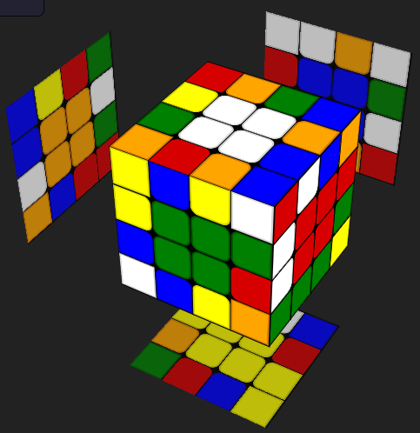
General Concepts
All center pieces are positioned on inner layers
↓
Only turns involving inner layers will affect center pieces
e.g., slice turns and wide turns

Slide 4
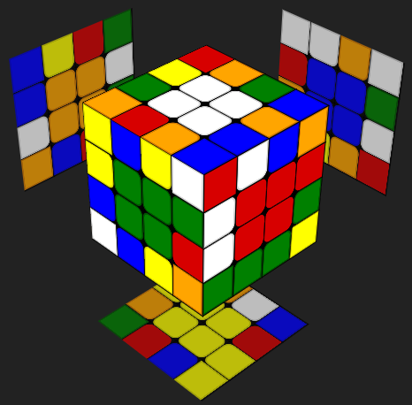
Solving Order
5.
Most commonly:
White
Center opposite to 1st
e.g., Yellow
Any of the last 4 centers
e.g., Green
Either center adjacent to 3rd
e.g., Red
Last 2 centers simultaneously
e.g., Blue and Orange
1.
2.
3.
4.

Slide 5
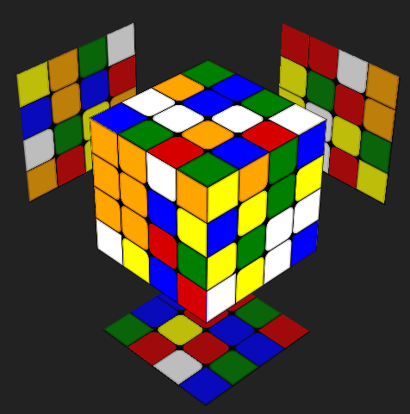
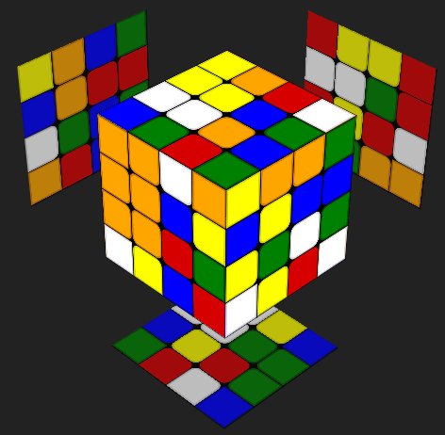
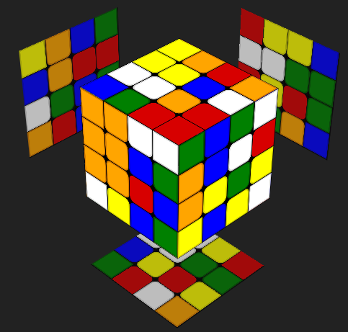
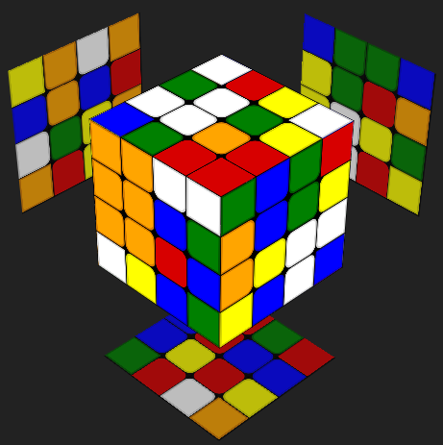
Half-Center Construction
Center pieces on same face but not adjacent
Center pieces on different faces but not “in-line”
Center pieces on different faces and “in-line”
Center pieces on same face and paired
*Inner turns and wide turns can be used interchangeably during centers construction

Slide 6
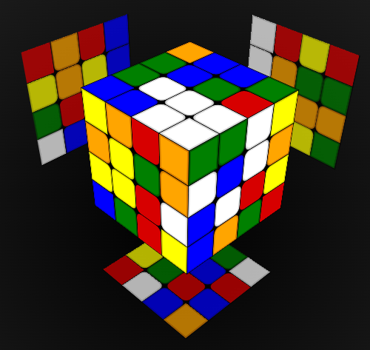
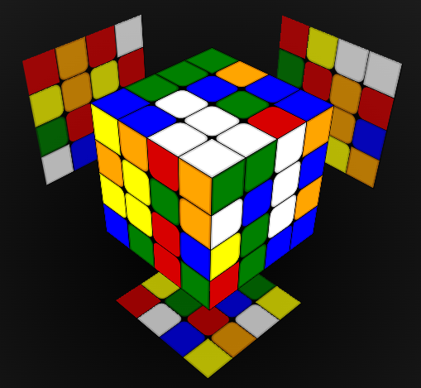
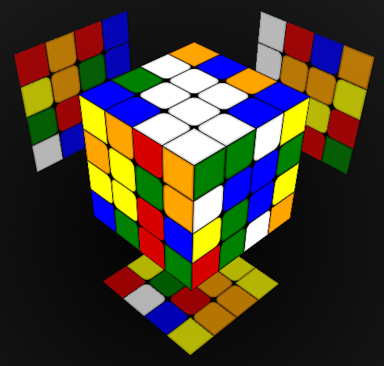
Full-Center Construction
One half-center completed
Both half-centers completed but not aligned
Half-centers aligned = center completed

Slide 7
1st and 2nd Centers
1st center is easiest – no solved groups to preserve
2nd center is always opposite 1st center
Any move affecting 2nd center will also affect 1st center

Slide 8
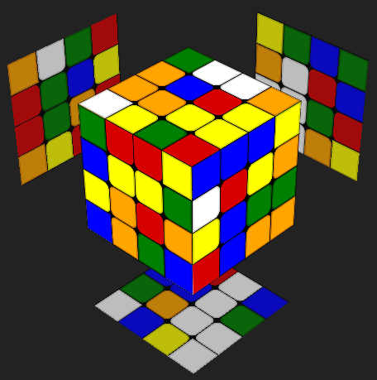
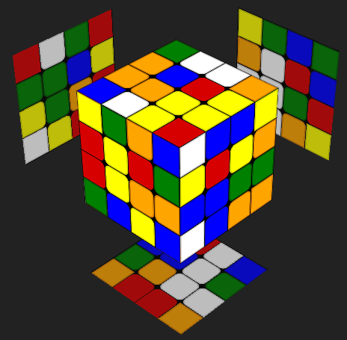
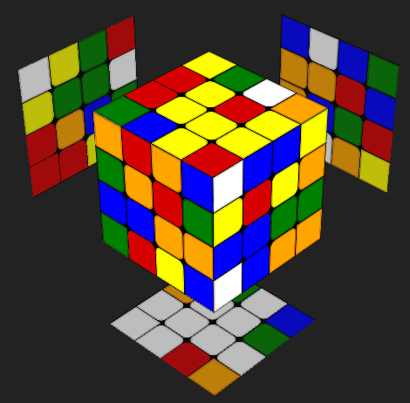
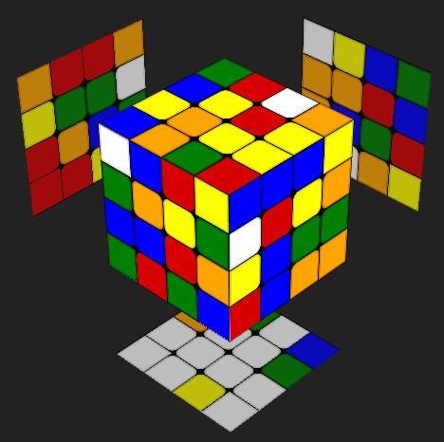
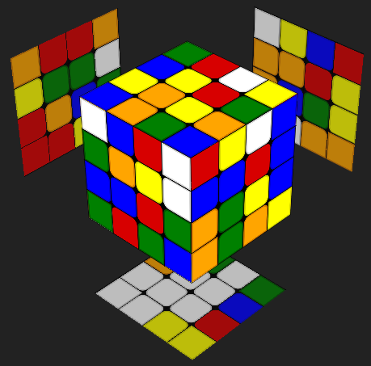
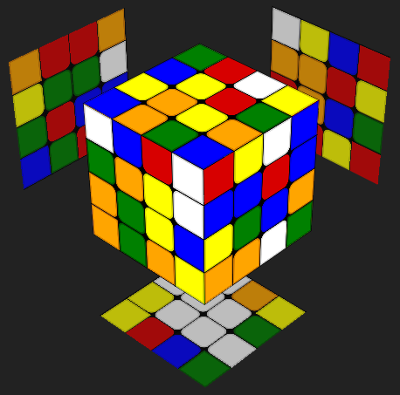
2nd Center Complications
Option 1: “Capture” center piece directly into top layer
Need to solve this center…
Option 2: Construct half-centers in middle layers
…while preserving this center

Slide 9
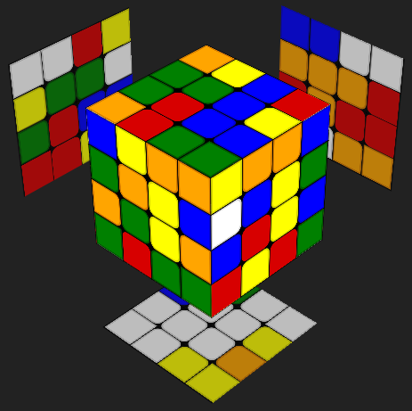
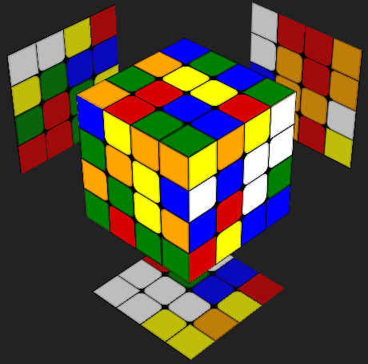
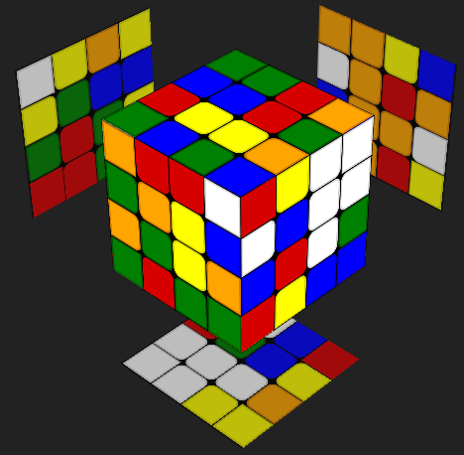
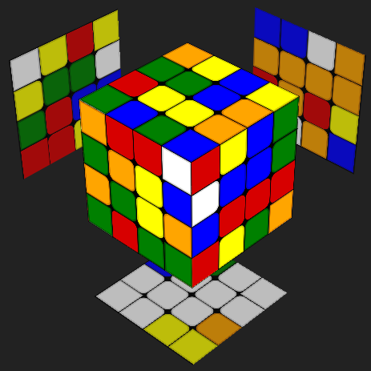
Half-Center Positioning
Position yellow half-center in top layer (also separates white center)
Rotate yellow half-center onto opposing middle slice
Restore white center

Slide 10
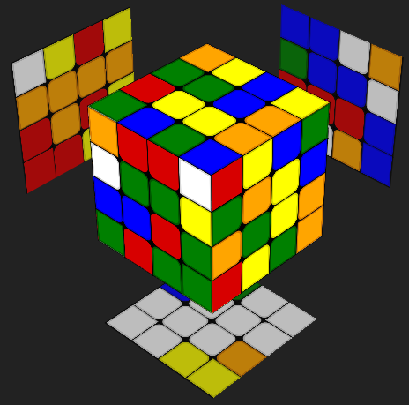
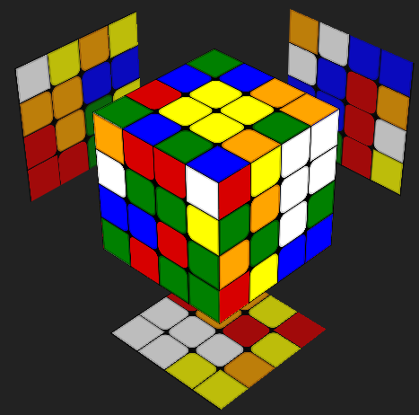
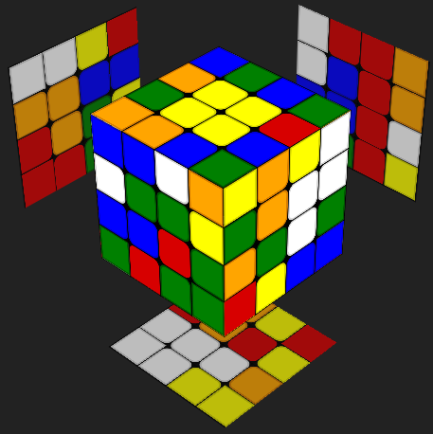
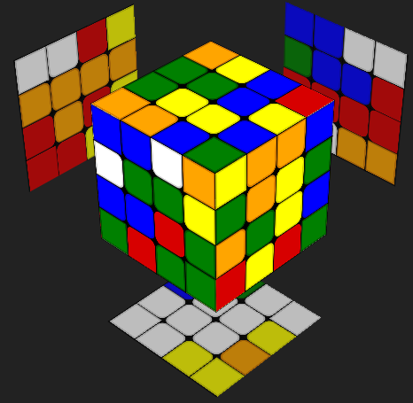
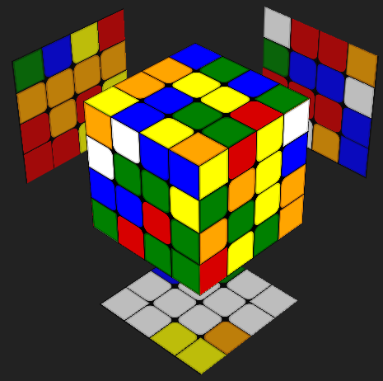
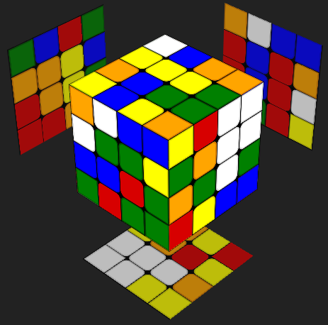
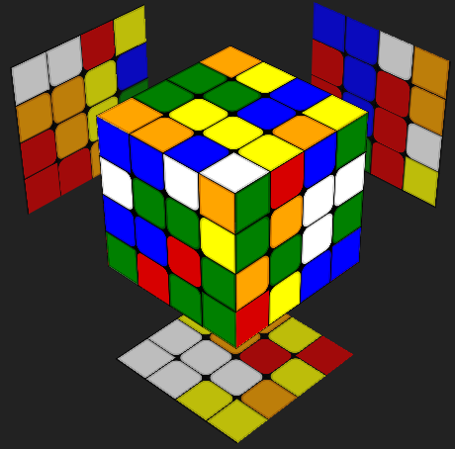
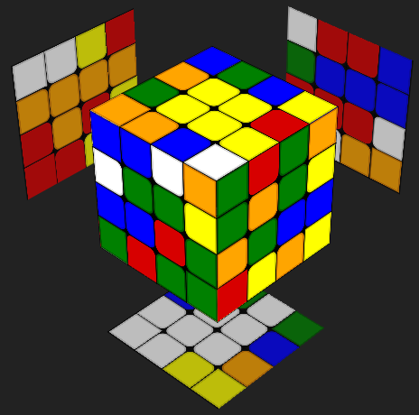
Half-Center Displacement
Problem: One yellow half-center is already in the top layer, so positioning the other yellow half-center into the remaining empty space WILL NOT work.
Solution: Temporarily displace the top layer yellow half-center with the middle layer yellow half-center to complete the yellow full-center.

Slide 11
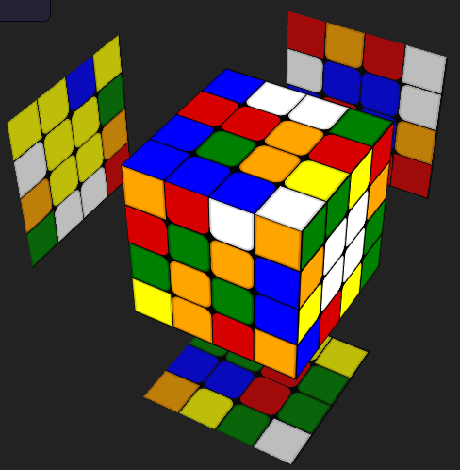
3rd Center
These 4 remaining centers can be solved using only outer face turns with 2R/Rw and 2L/Lw moves
3rd center solving is mostly identical to 1st center solving
All unsolved centers follow the same axis of rotation
↓
No need to use moves affecting white and yellow centers
Blue, Green, Red, and Orange are all located along the x-axis, which corresponds to R/L

Slide 12
4th Center
4th center should be adjacent to 3rd center
Also very similar to 2nd center solving
Any move affecting 4th center will also affect 3rd center
-> will need to use displacement

Slide 13
5th and 6th Centers
Should be adjacent
Can technically be opposite, but this is harder to solve
Use piece swaps and displacements

Slide 14
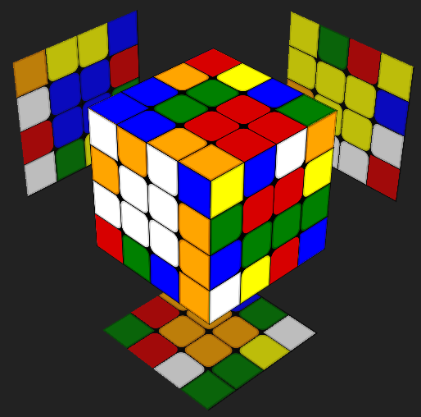
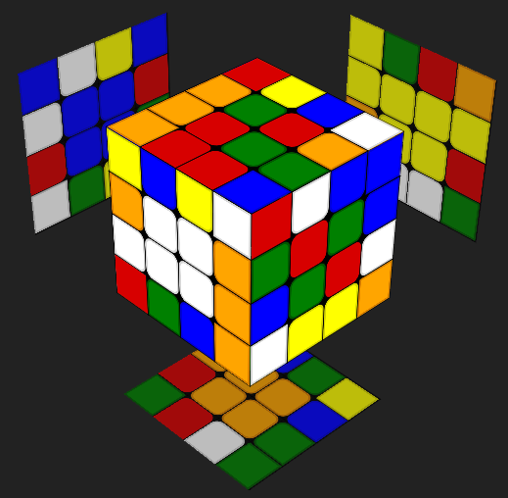
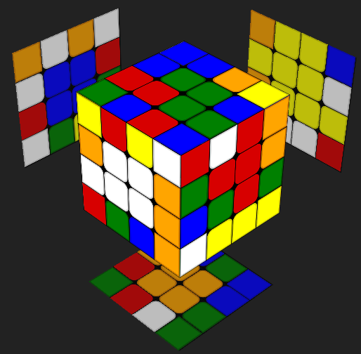
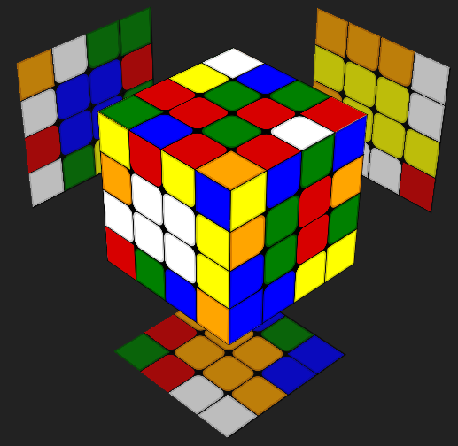
5th and 6th Centers Example Cases
Notes:
Example 1: https://www.cubedb.net/?puzzle=4&scramble=F-_L2_B_R2_B-_L2_U2_B2_D2_F_L2_F_R_U2_B_D_U_L-_F2_U_Uw2_Fw2_Rw2_F_Uw2_L_F_R2_B-_R2_B-_R2_Uw_F_L_U2_B-_Fw_R2_Uw_U_Rw-_D-_L-&alg=F_Rw_R2_Bw_Uw_U_Fw2_B2_Rw_B2_Rw-_%2F%2F_white_and_yellow_centers%0AU_Fw-_D_Fw2_%2F%2F_blue_center%0AR-_Bw_R-_D_Bw2_D2_Bw_%2F%2F_orange_center%0Ax_z
Example 2: https://www.cubedb.net/?puzzle=4&scramble=F-_L2_B_R2_B-_L2_U2_B2_D2_F_L2_F_R_U2_B_D_U_L-_F2_U_Uw2_Fw2_Rw2_F_Uw2_L_F_R2_B-_R2_B-_R2_Uw_F_L_U2_B-_Fw_R2_Uw_U_Rw-_D-_L-&alg=F_Rw_R2_Bw_Uw_U_Fw2_B2_Rw_B2_Rw-_%2F%2F_white_and_yellow_centers%0AU_Fw-_D_Fw2_%2F%2F_blue_center%0AR-_Bw_R-_D_Bw2_D2_Bw_%2F%2F_orange_center%0Ax_z_Rw_U_Rw-
Example 3: https://www.cubedb.net/?puzzle=4&scramble=F-_L2_B_R2_B-_L2_U2_B2_D2_F_L2_F_R_U2_B_D_U_L-_F2_U_Uw2_Fw2_Rw2_F_Uw2_L_F_R2_B-_R2_B-_R2_Uw_F_L_U2_B-_Fw_R2_Uw_U_Rw-_D-_L-&alg=F_Rw_R2_Bw_Uw_U_Fw2_B2_Rw_B2_Rw-_%2F%2F_white_and_yellow_centers%0AU_Fw-_D_Fw2_%2F%2F_blue_center%0AR-_Bw_R-_D_Bw2_D2_Bw_%2F%2F_orange_center%0Ax_z_U_Rw_U_Rw-
Example 4: https://www.cubedb.net/?puzzle=4&scramble=F-_L2_B_R2_B-_L2_U2_B2_D2_F_L2_F_R_U2_B_D_U_L-_F2_U_Uw2_Fw2_Rw2_F_Uw2_L_F_R2_B-_R2_B-_R2_Uw_F_L_U2_B-_Fw_R2_Uw_U_Rw-_D-_L-&alg=F_Rw_R2_Bw_Uw_U_Fw2_B2_Rw_B2_Rw-_%2F%2F_white_and_yellow_centers%0AU_Fw-_D_Fw2_%2F%2F_blue_center%0AR-_Bw_R-_D_Bw2_D2_Bw_%2F%2F_orange_center%0Ax_z_U_Rw_U_Rw-_Lw-_U2_Lw

Slide 15
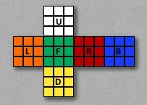
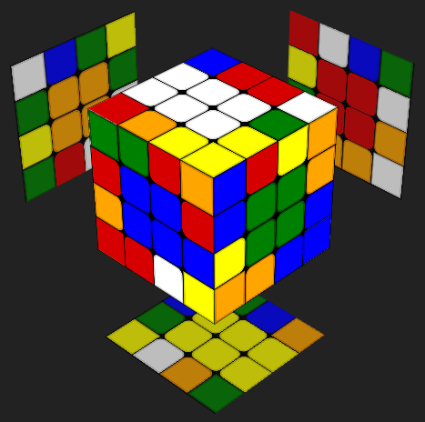
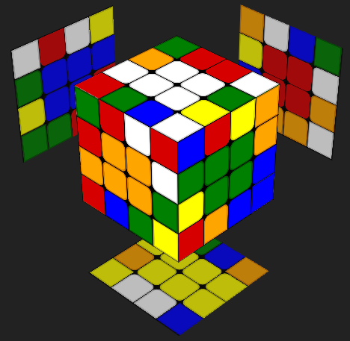
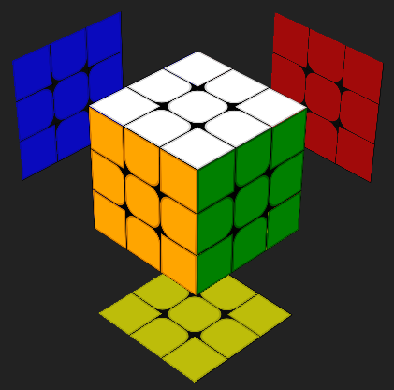
Fixing Color Schemes
Requires memorization of color placements
Wrong color scheme = must swap centers
Western color scheme
Blue and Orange swapped
INCORRECT COLORS
CORRECT COLORS
3x3 Reference

Slide 16
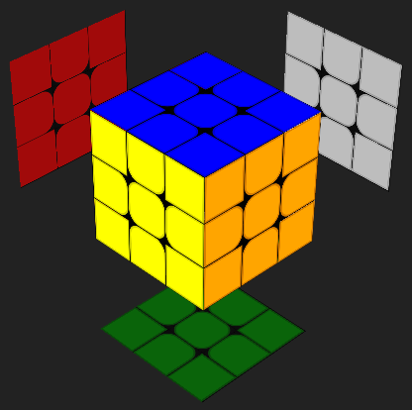
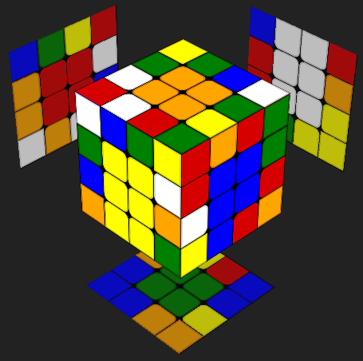
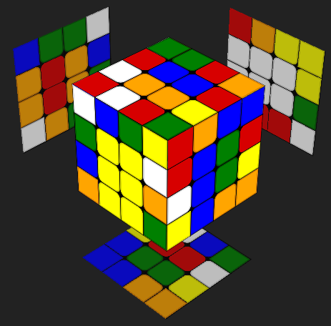
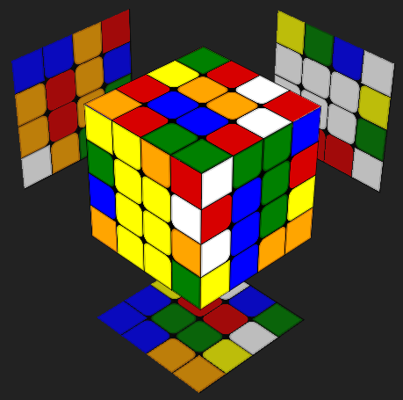
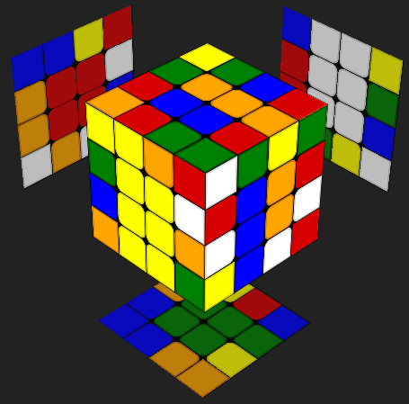
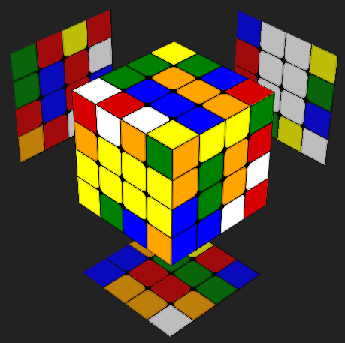
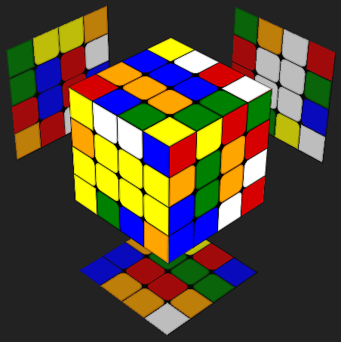
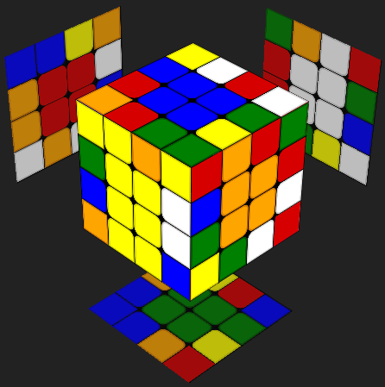
Swapping Adjacent Centers
Hold the two centers of interest on F and U
Rw U2 Rw’ Lw’ U2 Lw
Theory: Displace on the right to swap one set of half-centers, then displace on the left to swap the other set of half-centers.

Slide 17
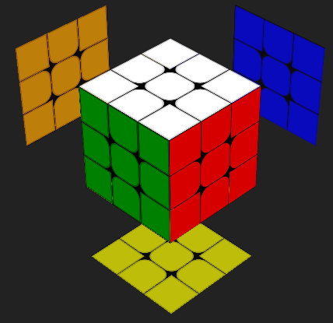
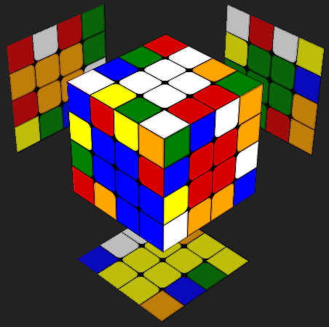
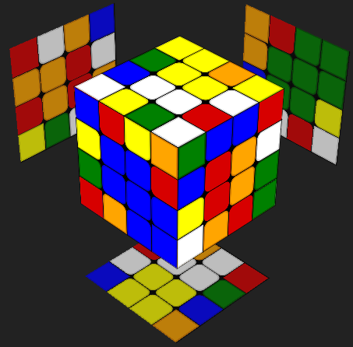
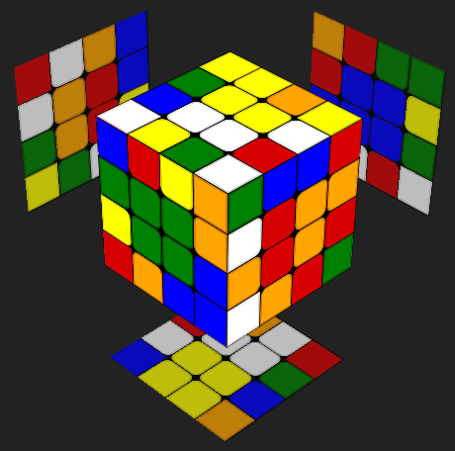
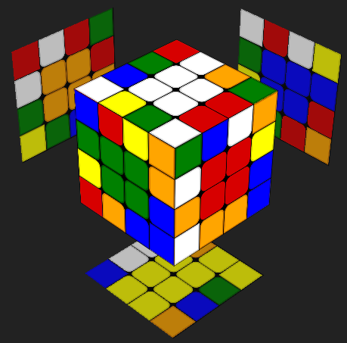
Swapping Opposite Centers
Hold the two centers of interest on L and R
Rw2 E2 Rw2
Theory: Offsetting the 4 correct centers by 180 degrees (via Rw2) gives them rotational symmetry.
Swapping the blue and green centers (via E2) will also swap the red and orange half-centers.
But, when the 4 correct centers are restored (via Rw2), the red and orange centers remain in place.

